Slide 1
UNIT 4
Inheritance, Pointers, Virtual Functions, Polymorphism

Slide 2
Contents
Derived Classes
Single, multilevel, multiple inheritance
Pointers to objects and derived classes
this pointer
Virtual and pure virtual functions.

Slide 4
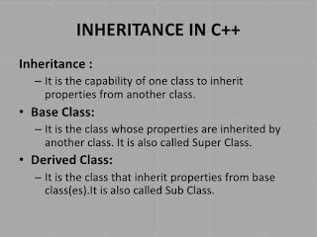
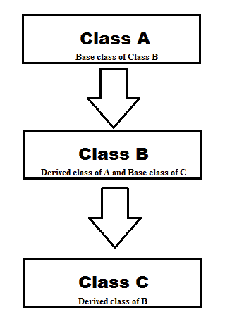

Slide 5
Types of Inheritance
Single Inheritance
Multiple Inheritance
Multilevel Inheritance
Hierarchical Inheritance
Hybrid Inheritance

Slide 6
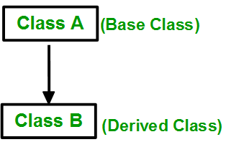
Single Inheritance: In single inheritance, a class is allowed to inherit from only one class. i.e. one sub class is inherited by one base class only.

Slide 7

Multiple Inheritance: Multiple Inheritance is a feature of C++ where a class can inherit from more than one classes. i.e one sub class is inherited from more than one base classes.

Slide 8
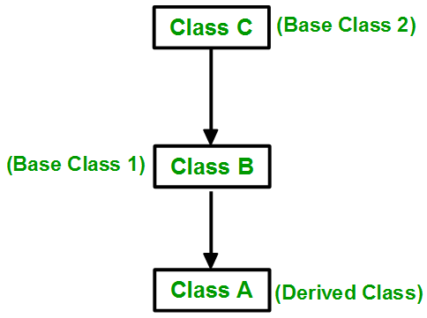
Multilevel Inheritance: In this type of inheritance, a derived class is created from another derived class.

Slide 9
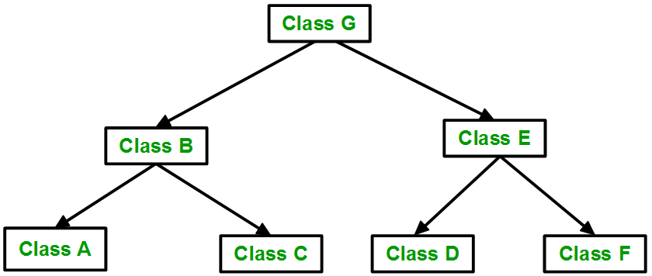
Hierarchical Inheritance: In this type of inheritance, more than one sub class is inherited from a single base class. i.e. more than one derived class is created from a single base class.

Slide 10
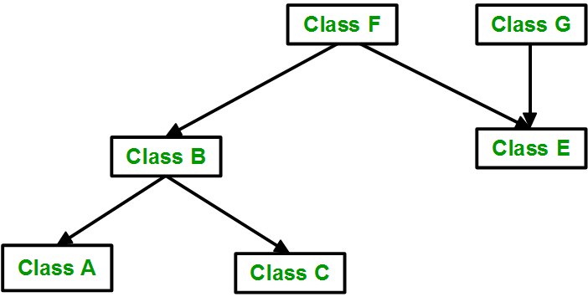
Hybrid (Virtual) Inheritance: Hybrid Inheritance is implemented by combining more than one type of inheritance. For example: Combining Hierarchical inheritance and Multiple Inheritance. Below image shows the combination of hierarchical and multiple inheritance:

Slide 12
Syntax
class derived-class-name: visibility-mode base-class-name
{
//Members of derived class
};
class derived : private base //private derivation (by default)
{ // Members of derived class
};
class derived : protected base //protected derivation
{ // Members of derived class
};
class derived : public base //public derivation
{ // Members of derived class
};

Slide 13
Modes of Inheritance
1) Public mode: If we derive a sub class from a public base class, then the public member of the base class will become public in the derived class and protected members of the base class will become protected in derived class.
2) Protected mode: If we derive a sub class from a Protected base class, then both public members and protected members of the base class will become protected in derived class.
3) Private mode: If we derive a sub class from a Private base class, then both public members and protected members of the base class will become Private in derived class.
Note: In all the above 3 modes, private members cannot be inherited.

Slide 14
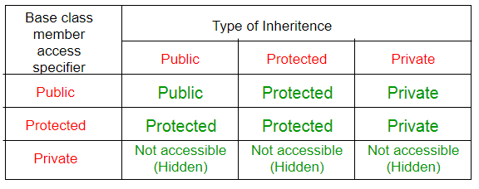
The below table summarizes the above three modes and shows the access specifier of the members of base class in the sub class when derived in public, protected and private modes:

Slide 17
Multilevel Inheritance

Slide 18
Multiple Inheritance

Slide 21
item *ptr = new item[10]; // ptr is a pointer to an array of 10 item objects
item *ptr[10]; // ptr is an array of 10 pointers to item objects

Slide 22
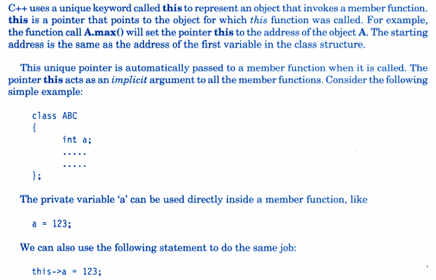
this pointer

Slide 24
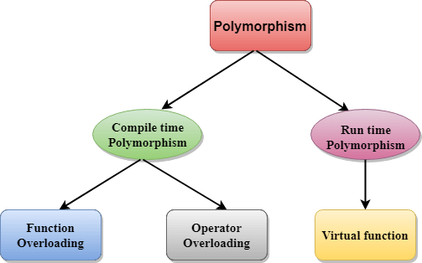
Polymorphism: It is derived from the words: poly meaning many and morph meaning form. Polymorphism is characterized by the phrase: “One Interface Multiple Methods”. It provides the advantage to re-use and extend code.
Types of Polymorphism

Slide 25
Virtual Function
A virtual function is a member function which is declared within a base class and is re-defined(Overriden) by a derived class.
Functions are declared with the virtual keyword in base class
Virtual functions ensure that the correct function is called for an object, regardless of the type of reference (or pointer) used for function call.
They are mainly used to achieve Runtime / Dynamic polymorphism
The resolving of function call is done at Run-time.

Slide 28
10) Program on virtual functions
Create a base class called Student and derived classes UGStudent and PGStudent. Demonstrate polymorphism using virtual functions to compute the total score as follows:
UGStudent - average of best two scores
PGStudent - addition of two scores

